Slide 1
Science
vocabulary
Notes:
All the definitions are pretty much straight out of dictionary.com.
I’ve put them in the notes section so teachers can adapt the explanations based on grade level and the precise science unit.

Slide 2
cause
Notes:
a person or thing that acts or happens or even just exists
in such a way that
some specific thing happens as a result
the thing that produces a result

Slide 3
to change
Notes:
to make the
form
nature
or content
of something
different from what it would be if it were left alone
(the change = the difference)

Slide 4
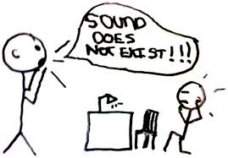
to claim
Notes:
to make a statement that you say is fact (it may or may not be true)!
(a claim = the statement)

Slide 5
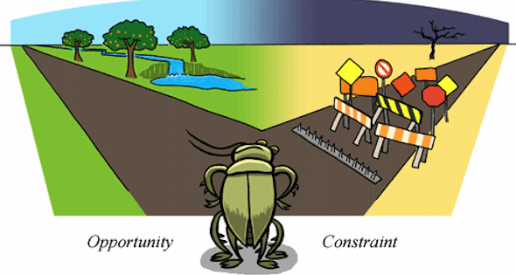
constraints
Notes:
limits or restrictions

Slide 6
criteria
Notes:
rules for evaluating or testing something

Slide 7
data
Notes:
facts
statistics
items of information

Slide 8
effect
Notes:
something that is produced by a cause
a result
a consequence

Slide 9
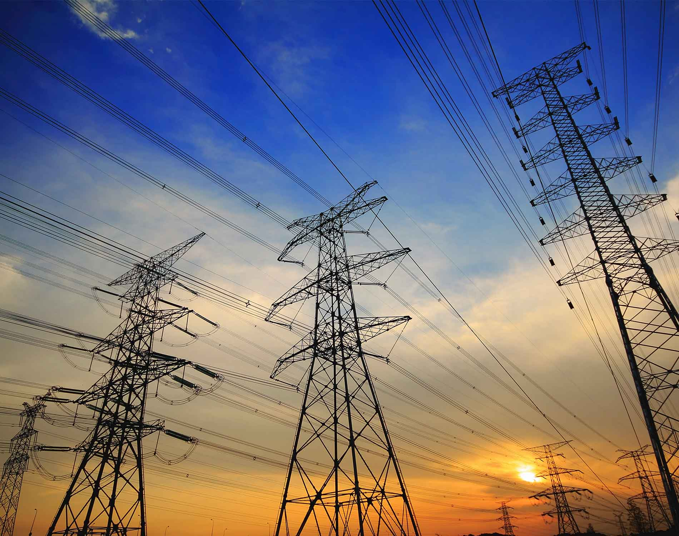
energy
Notes:
the capacity to do work
any source of useable power (fossil fuel, electricity, solar radiation)

Slide 10
evidence
Notes:
something that tends to prove or disprove a claim
the grounds for your beliefs

Slide 11
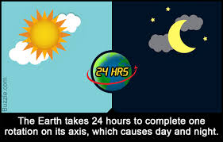
explanation
Notes:
a statement that explains or clarifies something to make it understandable

Slide 12
function
Notes:
the purpose something was designed for
the role of something
the kind of action or activity that the thing is made for

Slide 13
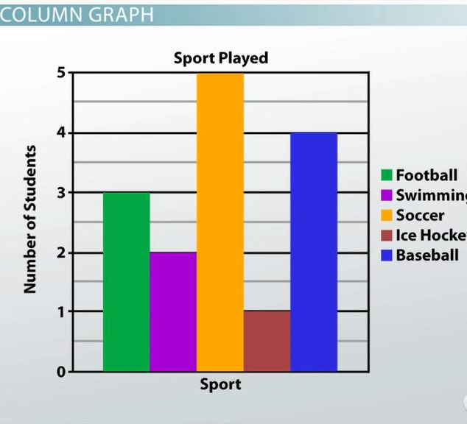
graph
Notes:
a diagram showing the relationships between two or more things with dots, lines, bars, etc.

Slide 14
infer
Notes:
to derive by reasoning
to conclude or judge from premises or evidence

Slide 15
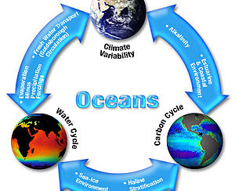
interaction
Notes:
the direct effect that one kind of particle has on another
any kind of reciprocal action, effect or influence

Slide 16
investigation
Notes:
a searching inquiry for facts
detailed and careful examination

Slide 17
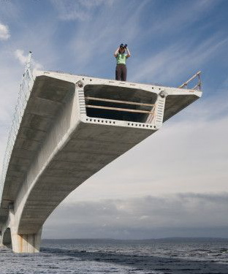
limitations
Notes:
restrictions

Slide 18
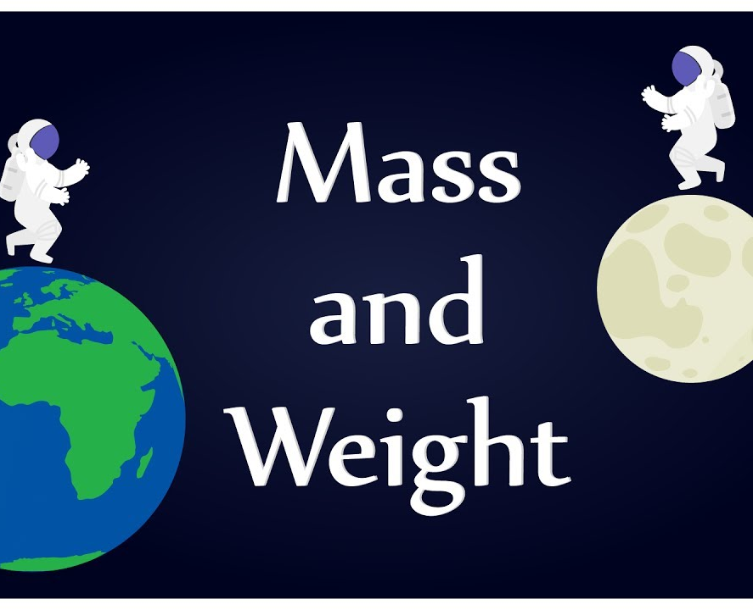
mass
Notes:
the amount of matter
(on Earth’s surface it is equal to weight)

Slide 19
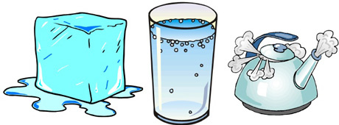
matter
Notes:
physical substance—solid, liquid, or gas
Matter is stuff. ☺

Slide 20
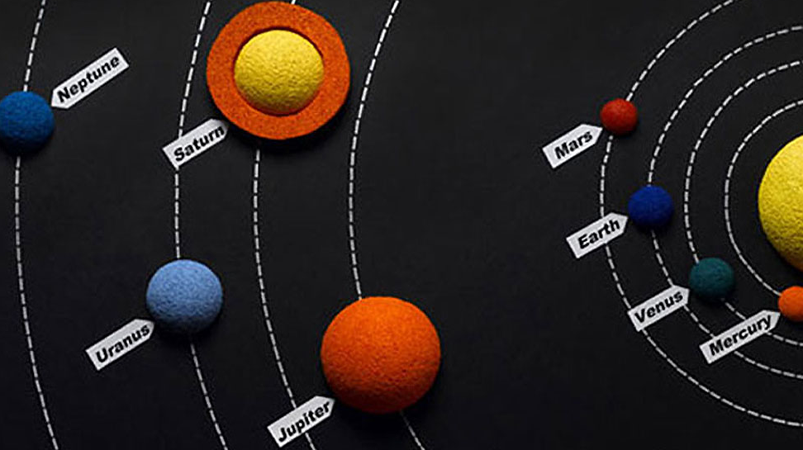
model
Notes:
a representation, usually in miniature, that shows how something looks or how it is constructed

Slide 21
observe
Notes:
to see, watch, perceive, or notice
to regard with attention, especially so as to see or learn something
to watch, view, or note for a scientific, official, or other special purpose

Slide 22
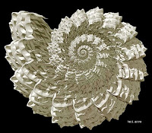
pattern
Notes:
a combination of
qualities
acts
tendencies
forming a consistent or characteristic arrangement
(The pattern shown is called a fractal—see how the repeating structures are in scale around a curve?)

Slide 23
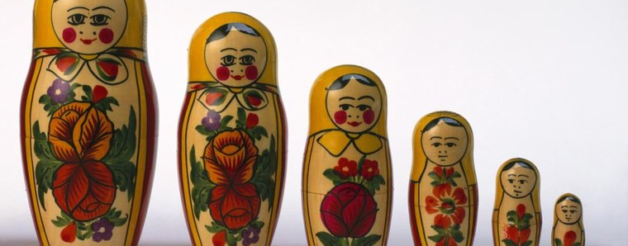
proportion
Notes:
ratio
relative size
comparative relation between things or magnitudes

Slide 24
quantity
Notes:
a particular amount
an indefinite amount
an exact measure

Slide 25
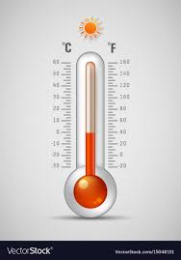
scale
Notes:
a series of marks used for measurement

Slide 26
solution
Notes:
an explanation or answer to solve a problem

Slide 27
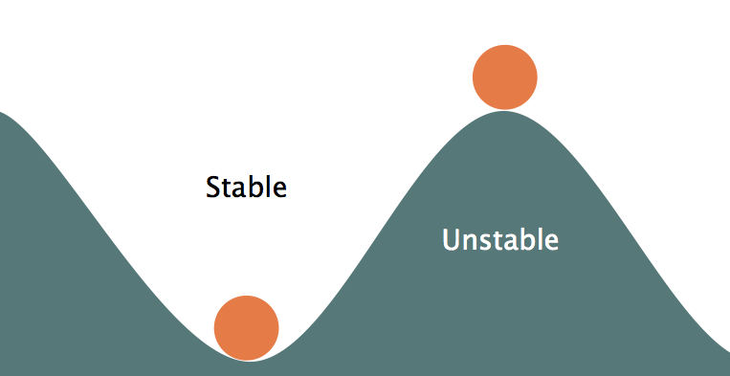
stability
Notes:
firmness in position
continuing without change—permanent (relatively, anyway)
resistance to chemical change

Slide 28
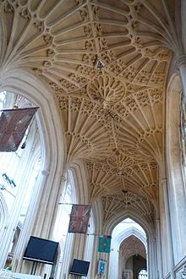
structure
Notes:
the whole system rather than any single part
something built or constructed
an organization of parts

Slide 29
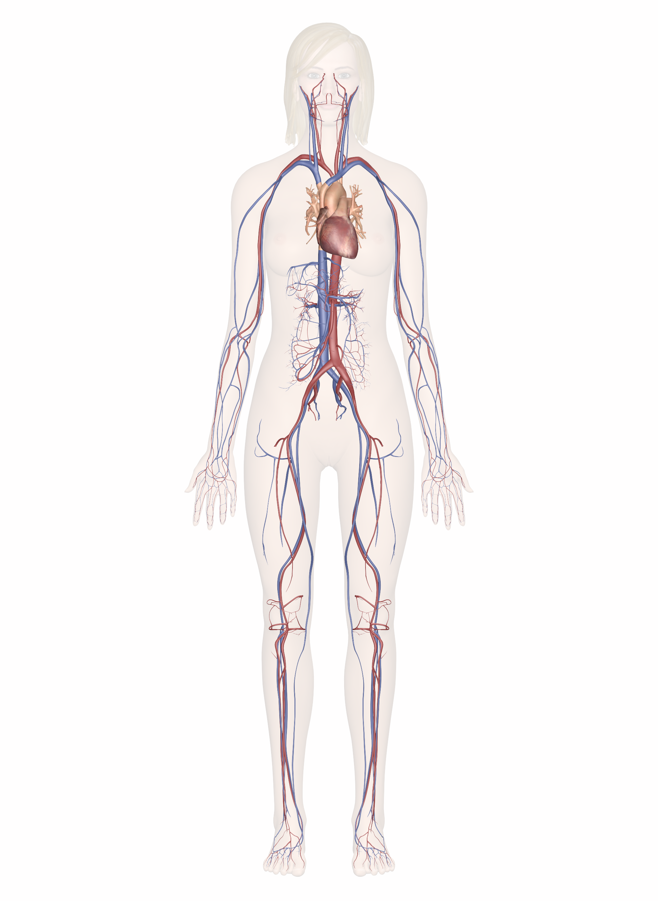
system
Notes:
a combination of things or parts making a complex whole

Slide 30
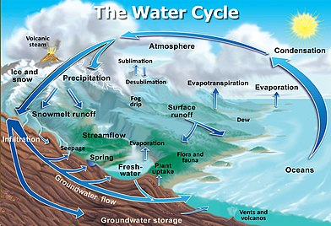
system model

Slide 31
volume
the degree of sound intensity or audibility; loudness:
Notes:
the amount of space (in cubic units) an object or quantity takes up

Slide 32
volume
volume
Notes:
the degree of sound intensity or audibility
loudness

